Slide 1


SEICHE 2023 Intermediate Arduino Programming for IoT
Instructor: Paul Frommeyer
www.paulfrommeyer.com
Corporate Sponsor: DXC Technology

Slide 2
REMINDER YOU MUST HAVE A WORKING LED MATRIX DISPLAY TO TAKE THIS CLASS! If displays are lost or damaged, replacements are $70 with 1-week lead time for replacement

Slide 3
Lesson Plan Overview
Lesson 1: 7Feb23 – Review, Addressing, and Pointers
Overview of lesson plan
Class Exercise: Validation of sketch uploading
Class Exercise: Validation of binary create and upload
More on the Preprocessor
Memory Organization and Variables
Review of addressing and pointers
Using pointers to variables
Declaring pointers in function calls
Call-by-value Function Calls
Call-by-reference Function Calls
Lesson 2: 14Feb23 – More Gory Details
Class Exercise: Call-by-reference variables
Introduction to Complex Data Structures
Using complex data structures
Storage declarations and Arduino
Lesson 3: 21Feb23 – Fonts Redux
MD_Parola library font usage review
The MD_Parola font format
Designing your own fonts
Declaring your own fonts
Using your own fonts with MD_Parola
Lesson 4: 28Feb23 – Intro to Visual Studio Code
Introduction to VSC
https://code.visualstudio.com/docs/introvideos/overview
VSCode Installation
VSCode Integration with Arduino and ESP8266
Lesson 5: 7Mar23 – Filesystems
Introduction to mass storage filesystems
The SD FAT, FAT16, and FAT32 filesystems
The exFAT filesystem
Introduction to SPIFFS
Class Exercise: Using SPIFFS
Lesson 6: 14Mar23 – WiFi
Review of WiFi technology (but no gory details)
Class Exercise: Review of WiFi access with WiFi Manager
Creating access points with ESP8266
Class Exercise: Creating an access point
Lesson 7: 21Mar23 – Web Technology
Introduction to HTML
Web server and client architecture
Creating web servers with ESP8266
Class Exercise: A basic web server for time and temperature
Lesson 8: 28Mar23 – Arduino Web Services
Storing web pages using SPIFFS
HTML forms
Form processing with Arduino
Class Exercise: Displaying text entered on a web page
Obtaining weather information from the Internet
Class Exercise: Displaying weather information
Lesson 9: 4Apr23 – IoT Messaging and MQTT
Introduction to IoT network messaging and MQTT
Subscribing to an MQTT service
Publishing to an MQTT service
Class Exercise: Using MQTT and WiFi
Lesson 10:11Apr23 – Version control and Git
The need for document version control
The Git version control system
Installing Git
Using Git
Introduction to Github
Using Github
Class Exercise: Signing up for a Github account
Lesson 11:18Apr23 – Using VSC
VSC plugin review
Using VSC with Arduino
Using VSC with Git

Slide 4

Flash Drive Contents Reminder
When I update parts of your flash drives, you can either recopy the entire section, or just copy the updated part.
However, you will need to explicitly copy any new files so that they are locally accessible on your laptops
Copying just lesson files will– wait for it!– copy only the lesson files.
Make certain you have copied everything in RED! You should already have previously copied everything else!
FLASH DRIVE
IntermediateProgramming-Software
Archive–BasicProgrammingWith Arduino-Fall2022
Archive-IntroductionToArduino-Spring2022
IntermediateProgramming-Software
IntermediateProgramming-Lessons
IntermediateProgramming-Documentation
Kubuntu
code_1.75.0-1675266613_amd64.deb
arduino-ide_2.0.4_Linux_64bit
Windows
VSCodeSetup-x64-1.75.0.exe
VSCodeUserSetup-x64-1.75.0
arduino-ide_2.0.4_Windows_64bit
IntermediateProgramming-Lessons
IntermediateProgramming-Documentation
IntermediateProgramming-Lesson1
IntermediateProgramming-Lesson2
IntermediateProgramming-Lesson3
IntermediateProgramming-Lesson4
ArduinoReference
Beginning C for Arduino, 2nd Edition
BoardsGuides
D1 Mini Reference
ElectronicsReference
IoT Reference
LED Matrix Display Architecture
HackSpace Magazine
Can’t do reading homework without the files!

Slide 5
Lesson 4 – Visual Studio Code
Part A
Arduino IDE Limitations
Introduction to VS Code
VS Code introductory videos
Part B
Installing VS Code
Kubuntu
Windows
Linking VS Code with the Arduino IDE
Assuring we have ESP8266 available in VS Code
Uploading a sketch using VS Code

Slide 6
Arduino IDE - Limitations https://learn.sparkfun.com/tutorials/efficient-arduino-programming-with-arduino-cli-and-visual-studio-code/all
The Arduino IDE lacks a number of "professional" code-assistance features, like:
Code navigation -- Whether it's find-by-reference (instantly navigating to the definition of the function you're using), search-by-symbol (quick navigation to function or symbol definitions within a file), or a quick link to a compilation error, code navigation is critical to managing large code bases.
Auto-Complete -- This feature can, of course, help complete long constant names, but it can also provide insight into the parameters that a function may expect.
Version control integration -- Whether you're using git or SVN, many modern IDE's provide source-control integration that can show, line-by-line, the changes you've made since your last commit.
Refactoring -- Need to overhaul a function's naming scheme? Or convert a common block of code into a function that can be more widely-used throughout your application? Sounds like a refactoring job! A modern IDE can help with that.
Integrated Terminal -- Whether you use bash or the Windows CMD, an integrated terminal can save you loads of time. This tool allows you to run "make", "grep", or any of your favorite terminal commands without ever swapping windows. [Especially true on Linux – PLF]
Once you take the time to learn these tools they make programming in C/C++ (or any language, really) so much more efficient. They help produce better code faster.

Slide 7
Visual Studio Code https://code.visualstudio.com/docs
Visual Studio Code is a lightweight but powerful source code editor which runs on your desktop and is available for Windows, macOS and Linux. It comes with built-in support for JavaScript, TypeScript and Node.js and has a rich ecosystem of extensions for other languages and runtimes (such as C++, C#, Java, Python, PHP, Go, .NET).
Visual Studio Code, also commonly referred to as VS Code, is a source-code editor made by Microsoft with the Electron Framework, for Windows, Linux and macOS. Features include support for debugging, syntax highlighting, intelligent code completion, snippets, code refactoring, and embedded Git.

Slide 8
VSCode – Introductory Videos https://code.visualstudio.com/docs/introvideos
Overview https://code.visualstudio.com/docs/introvideos/overview
Basics https://code.visualstudio.com/docs/introvideos/basics https://youtu.be/B-s71n0dHUk
Code Editing https://code.visualstudio.com/docs/introvideos/codeediting
Extensions https://code.visualstudio.com/docs/introvideos/extend

Slide 9
VSCode – Arduino Setup
Bye Bye Arduino IDE – Welcome VSCode – “RoboCircuits” https://www.youtube.com/watch?v=WVZxK2MEbE4
Setup and program NodeMCU esp8266 using Arduino VSCode extension – “Dr. Sensor” https://www.youtube.com/watch?v=UOsv7dwXuaA

Slide 10
VSCode – Arduino Setup [Note: These are reference pages, not videos]
Using VS Code for Arduino https://maker.pro/arduino/tutorial/how-to-use-visual-studio-code-for-arduino
Arduino CLI and VSCode https://learn.sparkfun.com/tutorials/efficient-arduino-programming-with-arduino-cli-and-visual-studio-code/all
Programming ESP and other Arduino compatible chips using VS Code on MacOS https://blog.anoff.io/2020-12-programming-arduino-esp-with-vs-code/

Slide 11
Formal End of Lesson 4
HOMEWORK
Check the Internet for more articles or videos on Visual Studio Code and Arduino
For the adventurous, you can search for articles on using PlatformIO with VSCode.
In next week’s exciting episode
Video – Installing Visual Studio Code
Video – Using Visual Studio Code with Arduino
Class Exercise – Installation of Visual Studio Code
Instructor’s time permitting – More on Parola font usage

Slide 12
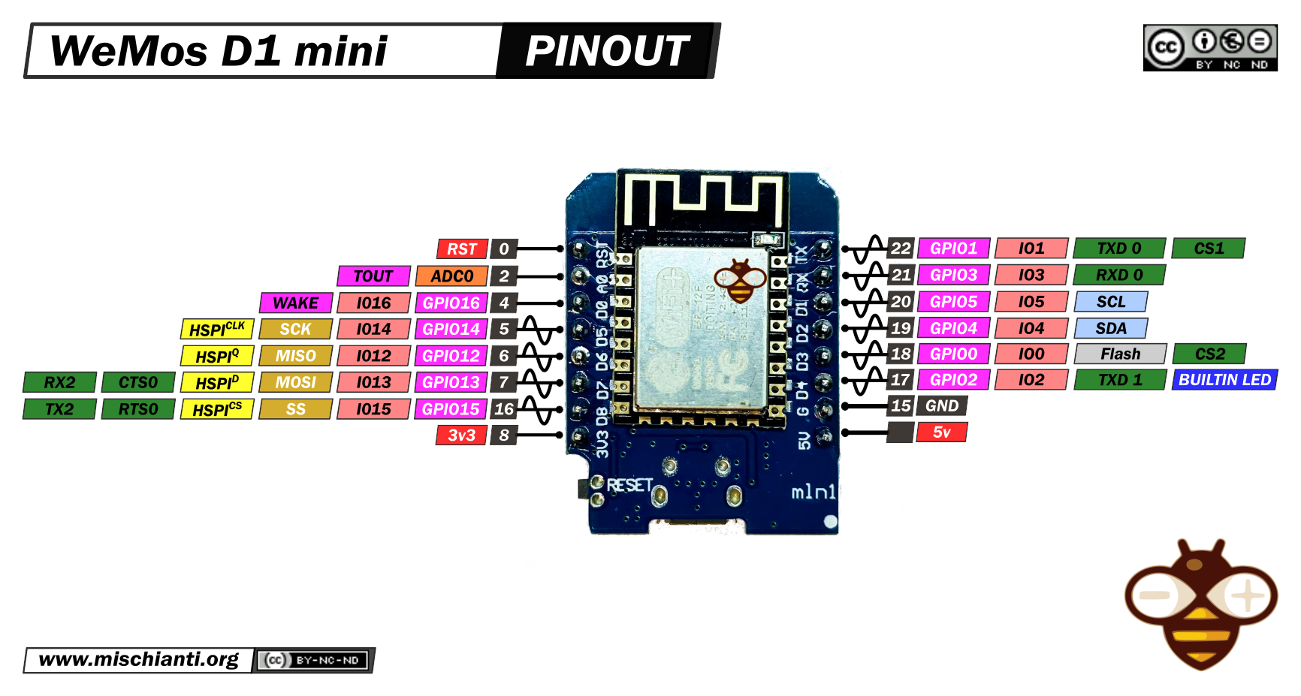
Our Microcontroller: The WeMos D1 Mini
Hilights
11 digital IO: all are interrupt and pwm capable (except D0/GPIO16)
1 analog input (3.2V max input): A0/ADC0
Micro USB or Type-C USB Port (clones usually have micro USB)
Two SPI interfaces (one is used for on-board flash memory), one I2C interface, two serial ports
Built-in WiFi (client or standalone access point modes) and Bluetooth
Compatible with MicroPython, Arduino, NodeMCU
Uses the CH340 USB-to-serial driver (installation usually needed on Windows)
Extremely low cost (approx $3.00 US on Amazon; one of the two least expensive components in your kits)

Slide 13
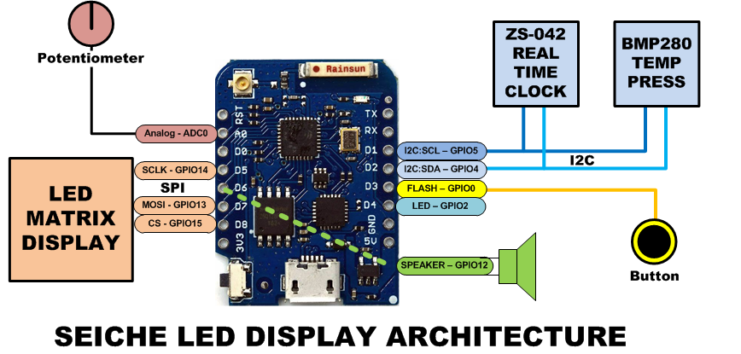
SEICHE LED Display Architecture
Red MAX7219 8x32 LED matrix display (SPI)
ZS-042 real-time clock module (I2C)
BMP280 Temperature and Pressure Sensor (I2C)
Piezoelectric speaker (PWM)
10KΩ Potentiometer (Analog-to-Digital Converter)
Button (Pullup and interrupt)

Slide 14
sprintf() Function Syntax
sprintf()’s formal syntax is: sprintf(char *buffer, const char *format, variable list)
buffer is an array of type char (the parameter when passed can also be a pointer [address] for such an array) which will contain the formatted output of the function
format is an unmodifiable (constant) array of char containing the format descriptors for all variables subsequently passed to the function, which is to say, it’s the format string.
The variable list are just the comma separated variables that are to be formatted
All variables passed in a single call to sprintf() are combined into a single output string
sprintf() automagically puts a terminating NULL (\0) at the end of the ASCII output

Slide 15
sprintf() Format Strings
sprintf() format strings contain conversion specifiers that specify how each individual variable is to be converted
sprintf() conversion specifiers have the following general syntax (all begin with a percent-sign):
%[flags][minimum field width][.][precision][length][conversion character]
% - special token that indicates the start of a conversion specifier
Flags – these modify the behavior of the specification
Minumum field width – as it says on the tin; this the minimum number of characters to be converted
. – The period is a separator between field width and precision
Precision – means one of the following depending on the variable type and conversion specifier
The maximum number of characters to be generated from a string
The number of digits after the decimal point for type float conversions (e, E, or f)
The zero-filled minimum number of digits for an integer
Conversion character – A single character which determines the output type of the conversion specifier; a single character that specifies the type of output format for the corresponding data or variable

Slide 16
sprintf() Conversion Specifiers
Below are the general conversion specifiers and what they do.
Specifier | What it does
d, i | int - integer; signed decimal notation
o | int – unsigned octal (no leading zero)
x, X | int – unsigned hexadecimal, no leading 0x
u | int – unsigned decimal
c | int – single character, after conversion to unsigned char
s | char * - characters from string are printed until \0 (NULL) or precision is reached
f | double – decimal notation of form [-]mmm.ddd where number of decimals is specified by precision; precision of zero (0) suppresses the decimals altogether
e, E | double - exp notation; default precision of 6, 0 suppresses
g, G | double – Use %f for <10^4 or %e for >10^4
p | void * - print output as a pointer, platform dependent
n | Number of characters generated so far; goes into output
% | No conversion, put a % percent sign in the output

Slide 17
sprintf() Conversion Specifiers
Below are the flags and what they do.
Flag | What it does
- | Left justification
+ | Always print number with a sign
spc (space) | Prefix a space if first character is not a sign
0 (zero) | Zero fill left for numeric conversions
# | Alternate output form depending on conversion character o – first digit will be zero x or X – 0x or 0X (respectively) prefixed to non-zero results e, E, f, g and G – Output will always have a decimal point g and G – trailing zeroes will never be removed

